Slide 1

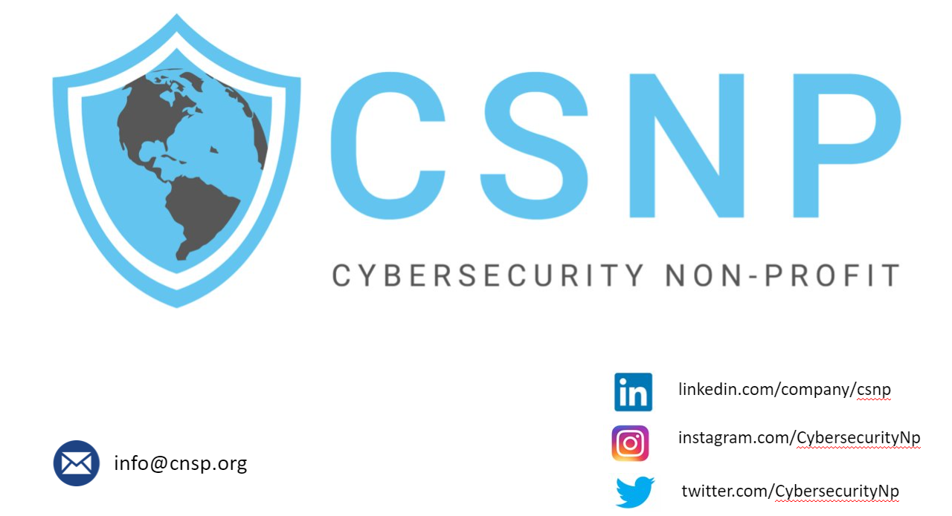

Slide 2
Identity and Access Management 101
By Andrew Chanthaphone
Manager @ Edgile

Slide 3
AGENDA
Who Am I?
Authentication
Authorization
IAM Branches
Common Terms
Governance
Major Players in IAM
How Do You Get Started

Slide 4
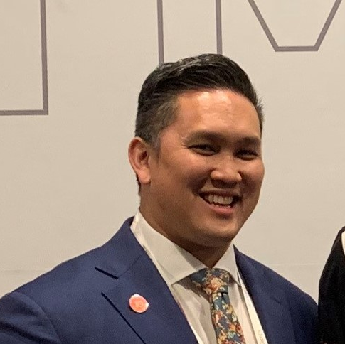



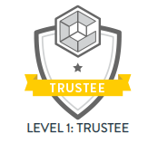

Who am I?
IAM Business Analyst/PM
Active in IAM ~7 years
Experience with government and commercial clients
Help customers stand up IAM practice or modernize current program
Enjoy learning customers’ current processes, creating efficiencies and streamlining practices
Diehard sports fan; lacrosse player; and family man
linkedin.com/in/andrewchanthaphone/
@andrewlax3
Notes:
Story – Talk about how you got into IAM (NSF)

Slide 5
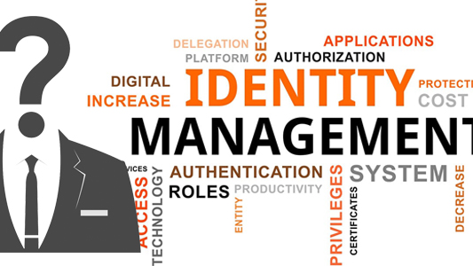
What is Identity and Access Management (IAM)
Gartner defines IAM as:
  the discipline that enables the right individuals to access the right resources at the right times for the right reasons

Slide 6
Authentication

Slide 7
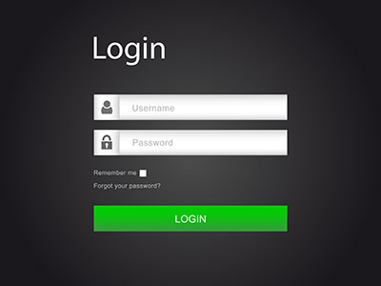
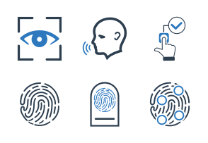
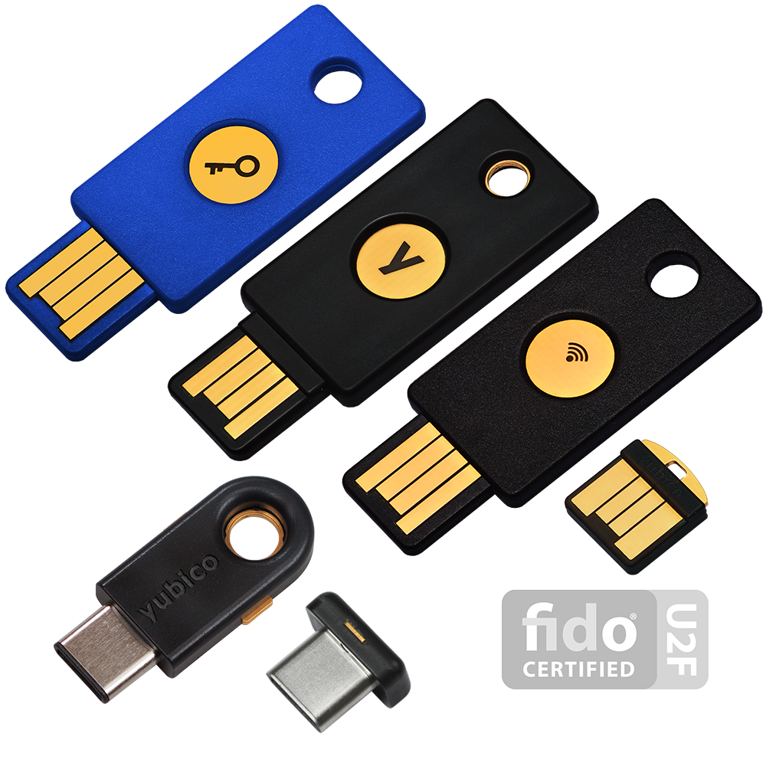

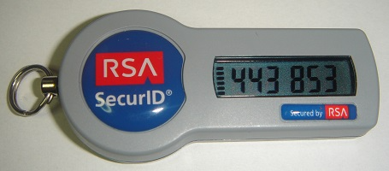
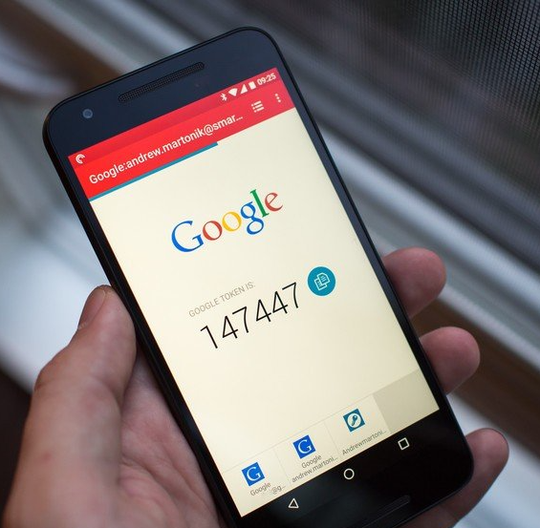
Authentication
How do you prove who you are?
Notes:
How do you prove you are? So many methods
Talk about the different ones
Classic Username and password
Biometrics
Smartphones, laptops, doors unlocks finger/face
Security keys/tokens – like Yuikeys and google’s Titan. They follow standards from identity orgs such as FIDO (Fast Identity Online), which is Authentication without using a password.
They provide standards such as using biometrics and security keys, which is a stronger approach vs. passwords
Just in time passwords also known as one time passwords
The password is used once
Token based is when you push on the button a new
Time based passwords

Slide 8
Authorization

Slide 9

Notes:
Now you have access, what doors or simple, what can I do? Can I do stuff that only admins can do or am I restricted
Can I use the internet or download attachments
Can I add programs to my computer

Slide 10

Zero Trust
Never trust, always verify
Assume breach
Verify explicitly
Notes:
This term in the cybersecurity field is as hot as everyone trying to go to Agile
This is a strategic framework that puts up barriers around access
Rather than once you are in, you get access to everything, Zero trust is more once I am in, I will only be granted just enough access based on attributes like time of login, location
Concepts like 2FA, PAM, and least priv are used here
Never trust, always verify – Treat every user, device, application/workload, and data flow as untrusted. Authenticate and explicitly authorize each to the least privilege required using dynamic security policies. •
Assume breach – Consciously operate and defend resources with the assumption that an adversary already has presence within the environment. Deny by default and heavily scrutinize all users, devices, data flows, and requests for access. Log, inspect, and continuously monitor all configuration changes, resource accesses, and network traffic for suspicious activity. •
Verify explicitly – Access to all resources should be conducted in a consistent and secure manner using multiple attributes (dynamic and static) to derive confidence levels for contextual access decisions to resources.

Slide 11
IAM Branches

Slide 12

IAM
Customer Identity and Access Management (CIAM)
Business 2 Business (B2B)
Workforce

Slide 13
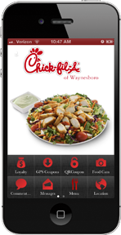
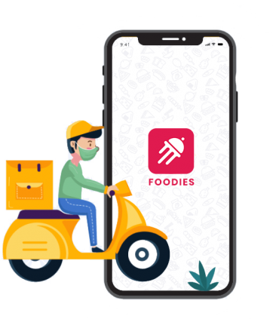

Consumer Identity and Access Management (CIAM)
Companies manage end-user access
Capture and maintain: Name, Address, Payment Information
IAM
Notes:
With COVID, the need for CIAM has exploded.
CFA, Doordash, UberEats, Uber
Get customers to create an account and maybe use a CRM tool to track what you buy

Slide 14

Business 2 Business (B2B)
Businesses allowing partners accessing internal applications
Partners identity information limited at times
IAM
Notes:
Companies that allow partners to access their site. e.g., amazon who has partners say salesforce access their internal network to do work or access amazon own applications
Another example is say a local bakery and needed to talk to supplies and vendor
Need access to system
Identities from other companies, limited information, how do you manage them?

Slide 15
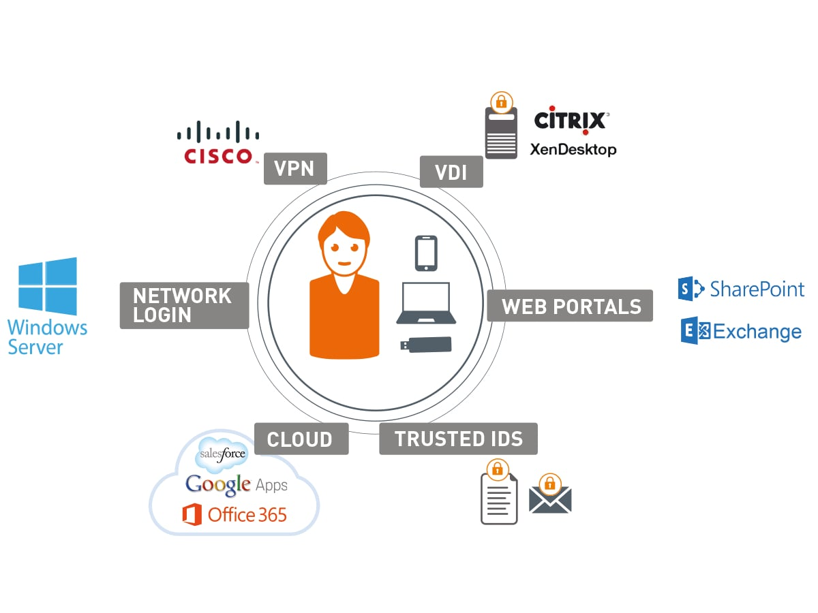
Workforce
Onboarding, Transfers, Leavers
Granting access via attributes or roles
Notes:
For those who are working, this is a combination of permissions you are given when you are hired
Think about when you started a new job, did you have everything you needed?
If not, that’s what workforce IAM is supposed to help fix
Day 1 of working we want to get you working and with the right permissions to the software/apps you should have access to
When you move depts, should you keep access to your apps or should you lose them and get new ones?
Leaver

Slide 16
Common Terms

Slide 17
Common Terms
Access Request
Roles
Entitlements
Multi-factor Authentication (2FA)
Lifecycle Management
Access Certification/Attestation
Least Privileged
Priveleged Access Management (PAM)
GDPR
Notes:
Access Request
MFA
Least Priv
Roles
LCM
PAM
Entitlements
Certs
GDPR – General Data Protection Regulation – EU, damn cookies, Launched in April 2016, the GDPR aimed to provide a single set of data privacy laws across the European Union, which provided higher levels of protection and rights to individuals than those already in place.
GDPR means reviewing how personal data is captured and used within an organization. In then ensuring compliance, it aims to provide data protection for European Union customer data, to reduce the severity and frequency of data breaches, and the potential for mishandling or misprocessing of personal data on the web
7 principles : Consent, Contract, Legal Obligation, Vital interest, Public task, Legitimate interest

Slide 18
Governance

Slide 19
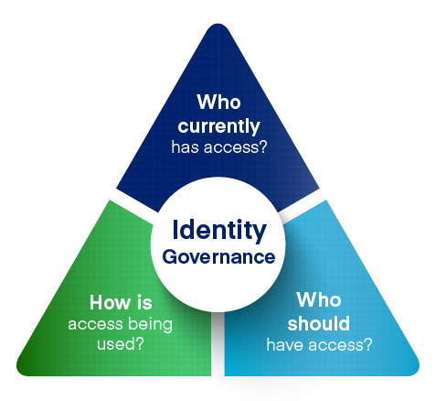
Source: SailPoint

Slide 20
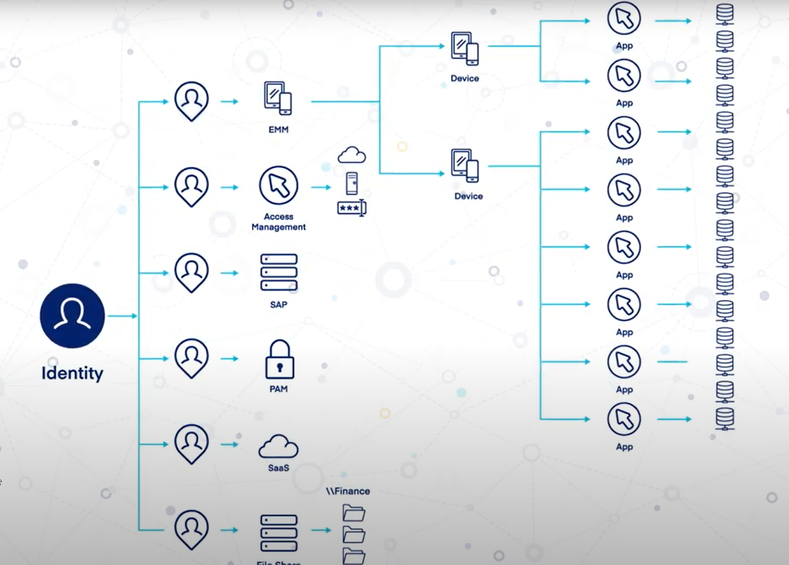
Source: SailPoint

Slide 21
Major Players in IAM

Slide 22




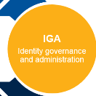






Slide 23
How Do you Get Started?

Slide 24



IAM Organizations
https://womeninidentity.org
https://idpro.org
https://www.idsalliance.org

Slide 25
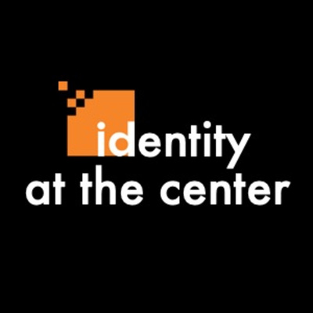

https://www.identityatthecenter.com/
https://www.identityatthecenter.com/
IAM MEDIA

Slide 26
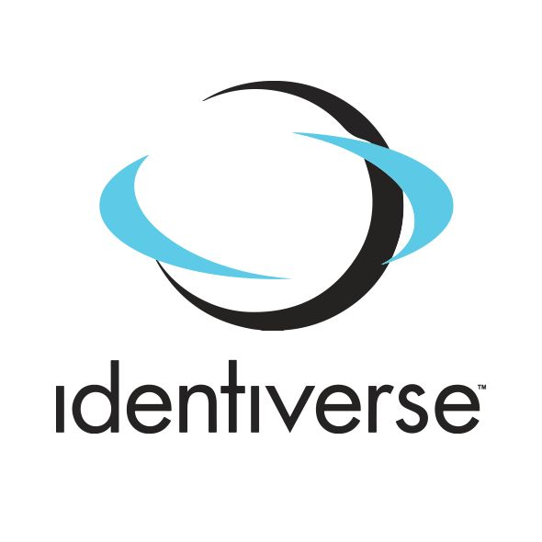
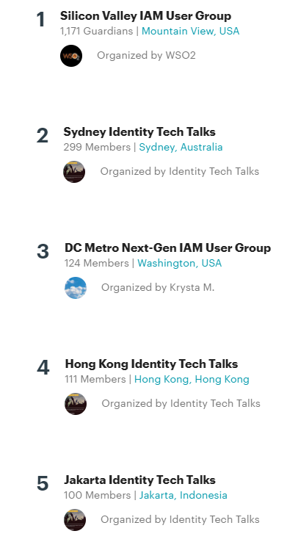
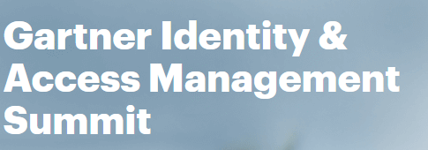
CONFERENCES/MEETUPS

Slide 27

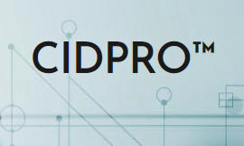
CERTIFICATIONS
https://identitymanagementinstitute.org/
https://idpro.org/cidpro/
Notes:
IDI – 8 different types of certs
Certified Identity and Access Manager (CIAM) certification is a registered and vendor-neutral IAM certification which is recognized globally as the Gold Standard certification of the identity and access management industry.
CIGE – Governance
CIPA – Identity Theft

Slide 28
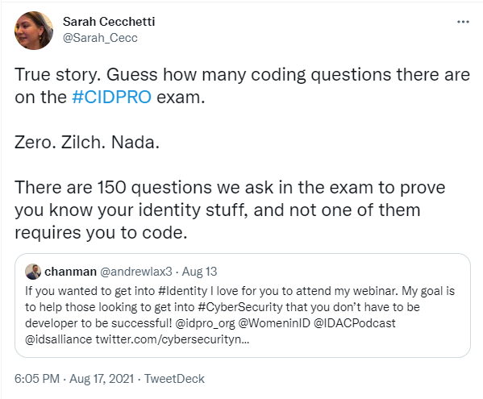
Summary
Notes:
Che-kei

Slide 29
QUESTIONS

